Slide 1
Configuring Cisco Routers

Slide 2
Cisco IOS Software
A router or switch cannot function without an OS.
Cisco calls its operating system the Cisco Internetwork Operating System or Cisco IOS.
The Cisco IOS provides the following network services:
  Basic routing and switching functions
  Reliable and secure access to networked resources
  Network scalability
Provides a command-line interface (CLI)
  Allows network operators to check the status of the router and network administrators to manage and configure the router

Slide 3
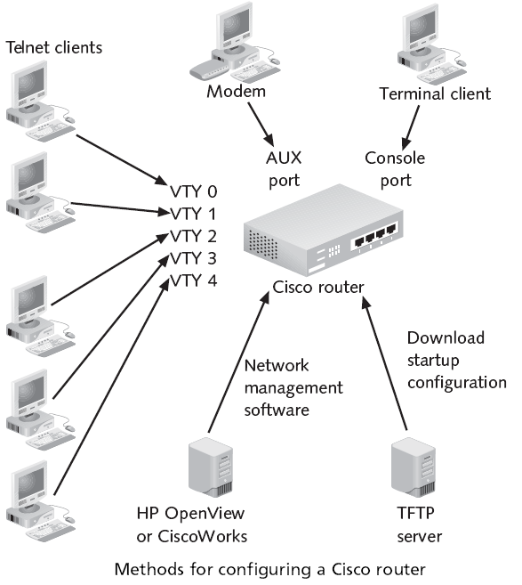
Configuration Sources
Router can be configured from:
  Console port (A console session).
  Auxiliary port (AUX) (A dialup connection using a modem).
  Virtual terminals (VTY) (Telnet session to the router).
  Trivial File Transfer Protocol (TFTP) server.

Slide 4
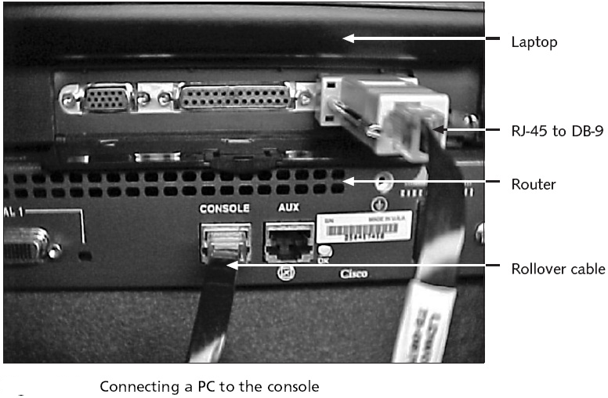
Configuration Sources

Slide 5
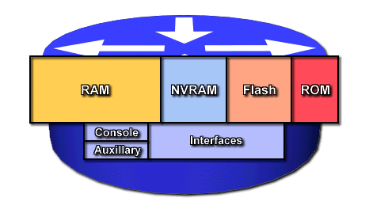
Router Components
RAM/DRAM
  Routing tables.
  ARP cache.
  Packet buffering
  Packet queues.
  RAM contents lost when power is lost.
NVRAM – nonvolatile RAM
  Router Configuration saved here
  Configuration loaded from here on startup
  NVRAM retains data when power is turned off.
Flash - erasable, reprogrammable ROM (EEPROM)
  OS image & microcode.
  Can have multiple copies of IOS.
  Flash contents are retained when power is turned off.
ROM - read only memory.
  POST (power on self test).
  Bootstrap program (boots router and loads the IOS)
  Operating system software.

Slide 6
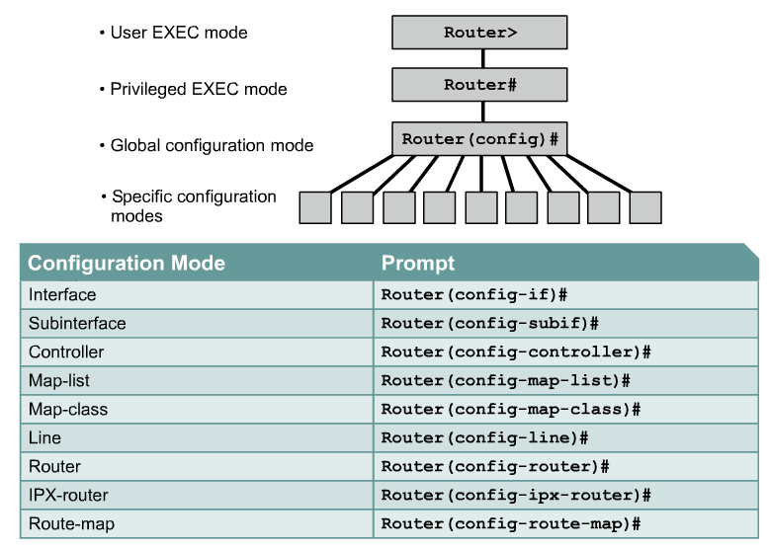
CLI command modes
Router> enable
Router# configure terminal
Router(config)# interface fa 0/0
Router(config-if)#

Slide 7
Cont..
User EXEC mode – allows the user to check the router status. No router configuration changes are allowed.
Privileged EXEC mode – allows the user to change the router configuration.
Global configuration mode – used to modify system wide configuration parameters .
Interface configuration mode – aallows you to configure the Ethernet and serial interfaces on your router.
Line configuration mode – allows to configure the virtual terminals, console, and AUX lines that let us access the router.

Slide 8
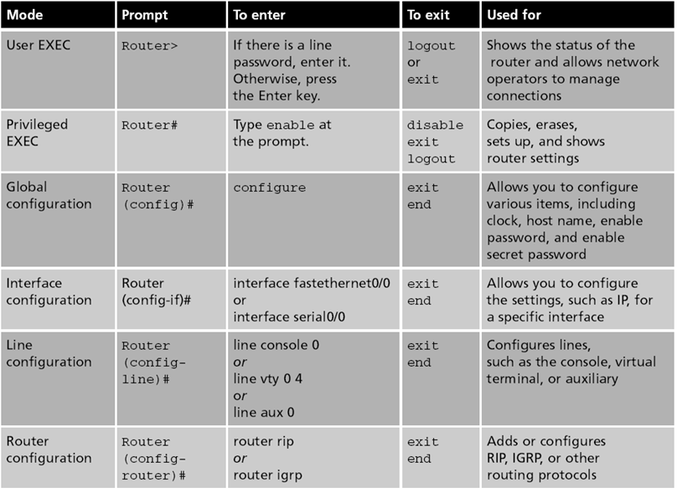

Slide 9
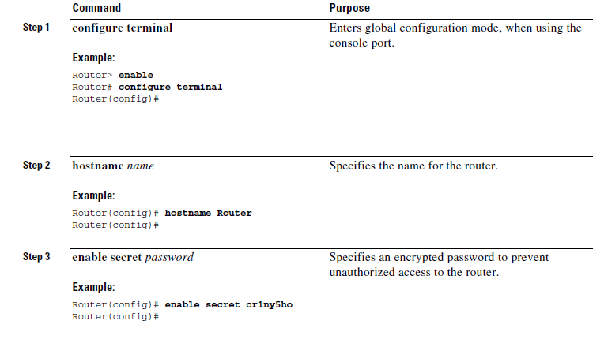
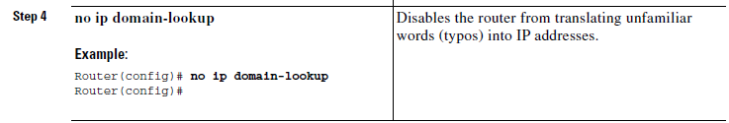
Configure Global Parameters

Slide 10
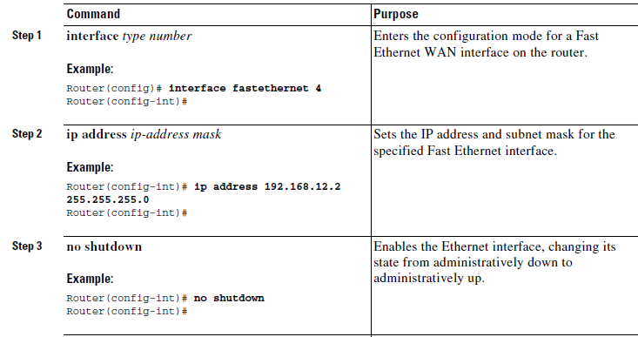
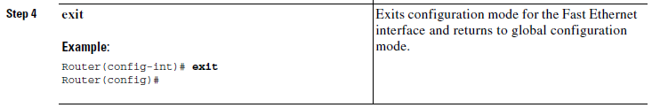
Configure the Fast Ethernet Interface

Slide 11
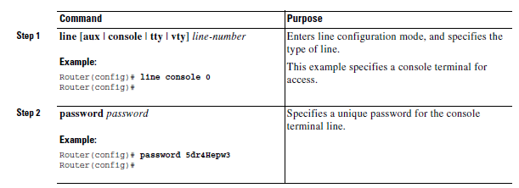
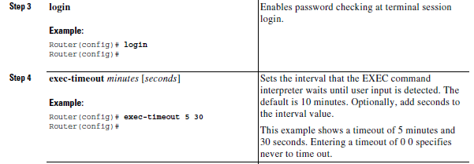
Configure Command-Line Access

Slide 12
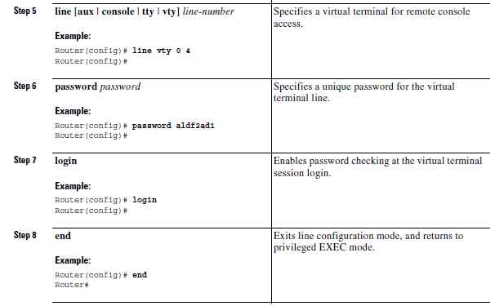
Configure Command-Line Access

Slide 13
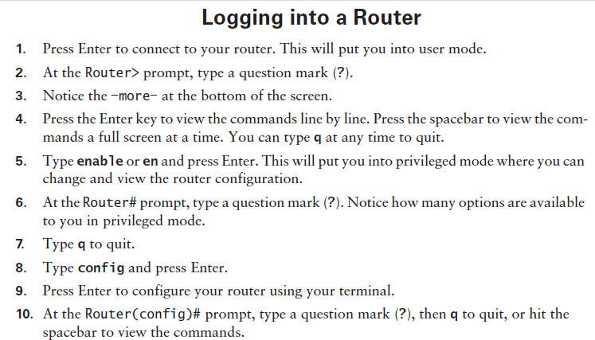

Slide 14
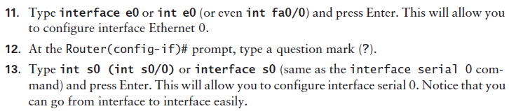
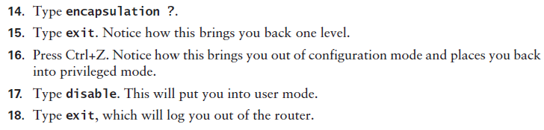

Slide 15
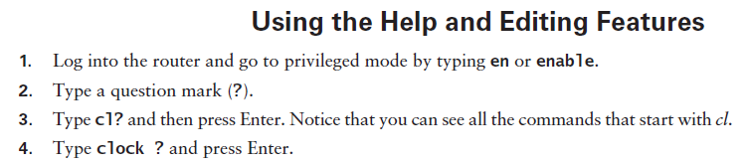
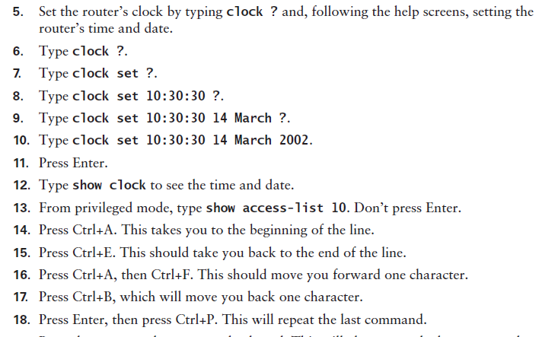

Slide 16


Slide 17
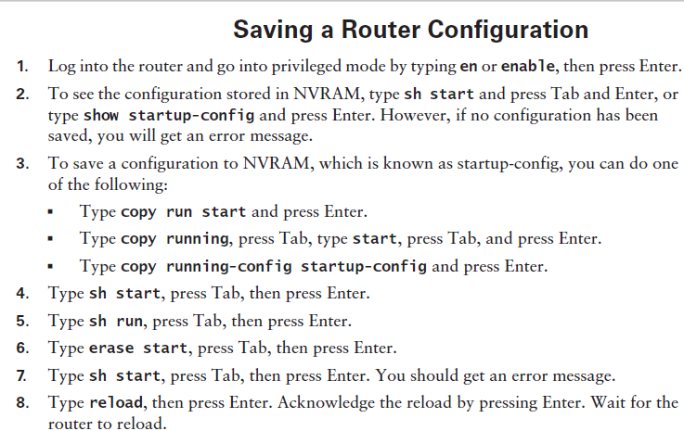

Slide 18
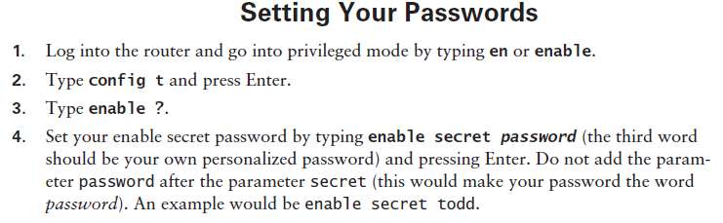
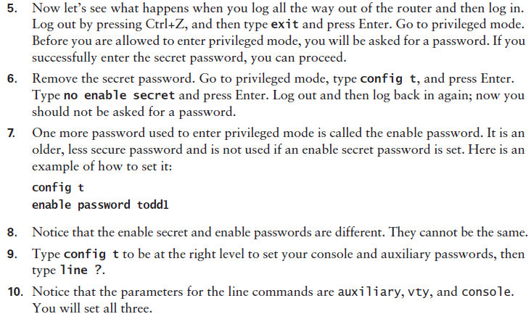

Slide 19
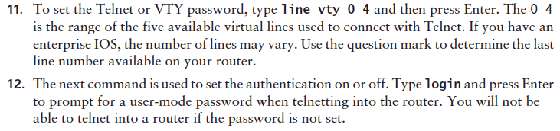
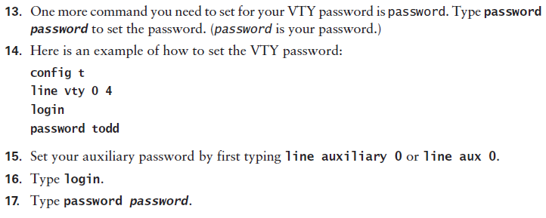

Slide 20
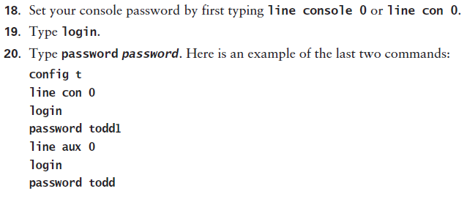
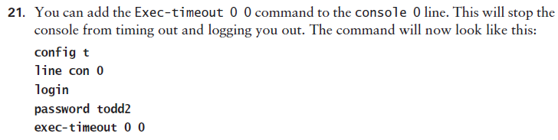

Slide 21
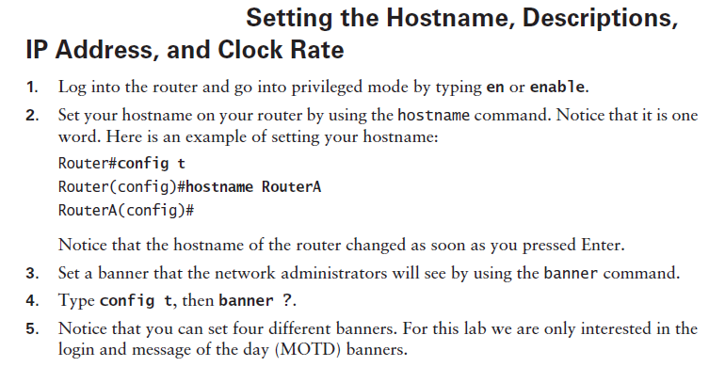

Slide 22
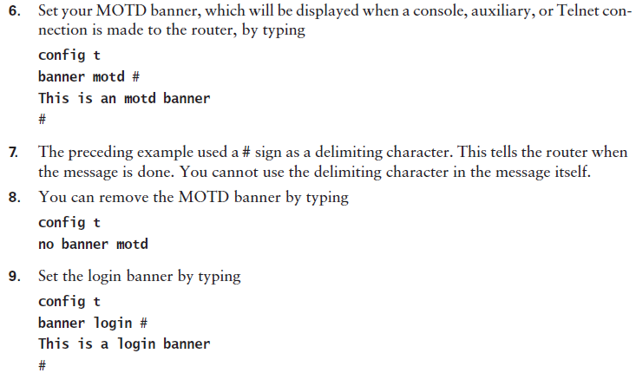

Slide 23
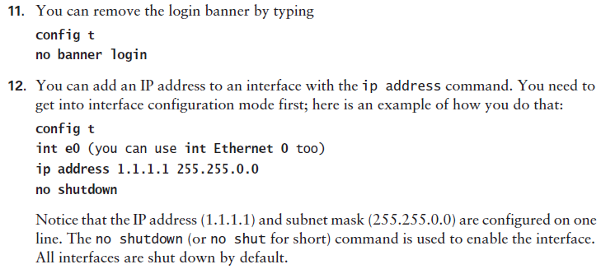
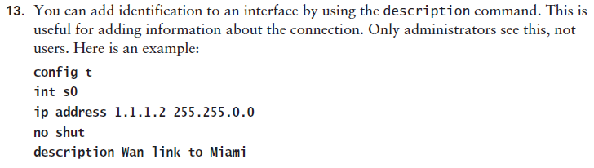

Slide 24
